Slide 1
GoMax Short Description
MATICONE LTD

Slide 2
Revision History
Version | Date | Description | Author
1.0 | March 25, 2026 | Initial Samsung TV Seller Office UI description for GoMax Short. | GoMax Team
1.0.1 | March 25, 2026 | Updated with actual application screenshots and navigation flow. | GoMax Team

Slide 3
Contents
UI Structure
Usage Scenario
Menu & Function Description
Navigation Flow
Key Policy
Language Support

Slide 4
UI Structure
Whole UI Structure
GoMax Short is a Samsung TV short drama streaming application
for browsing and watching free short drama series.
Only currently available user flows are described in this document.
Primary user flow:
Home -> Detail -> Player
Discover -> Detail -> Player
Main screens in the current release:
- Home: featured banner, popular dramas, and quick access cards
- Discover: category browsing, trending content, and new releases
- Detail: drama information, episode list, and related content
- Player: video playback with episode navigation
- My List: watch history and favorites
- Categories: browse by drama type

Slide 5
UI Structure - Flow Graph
Home
<->
Discover
v
Detail
v
Player

Slide 6
UI Structure - Depth Navigation
Depth 1 : Home, Discover
Depth 2 : Selected drama detail page
Depth 3 : Episode playback page
Global UI elements:
- Header navigation bar
- Focus highlight for remote-control navigation
Contextual UI elements:
- Episode list on Detail page
- Video area and episode list on Player page

Slide 7
Usage Scenario
Use Case 1: Browse and watch short dramas.
1. Navigate between Home, Discover, My List, and Categories with directional keys.
2. Browse featured dramas on Home or explore categories in Discover.
3. Select a drama card with the Enter key to view details.
4. Review drama information, synopsis, and episode list on Detail screen.
5. Select Play button or choose a specific episode to start watching.
6. Control playback with remote: play/pause, seek, next/previous episode.
7. Press Return to navigate back or access episode list.
8. Add dramas to favorites or view watch history in My List.
No account sign-in, activation, or purchase is required - all content is free!

Slide 8
Usage Scenario
Use Case Title: Navigate through main application screens
Path 1: Home -> Browse featured content
Path 2: Discover -> Explore categories and trending content
Path 3: My List -> View watch history and favorites
Path 4: Categories -> Browse dramas by genre
Supporting notes:
- The app follows Samsung TV navigation patterns.
- All content is completely free to watch.
- No account registration or payment required.
No account login is required.
No in-app purchase is required.

Slide 9
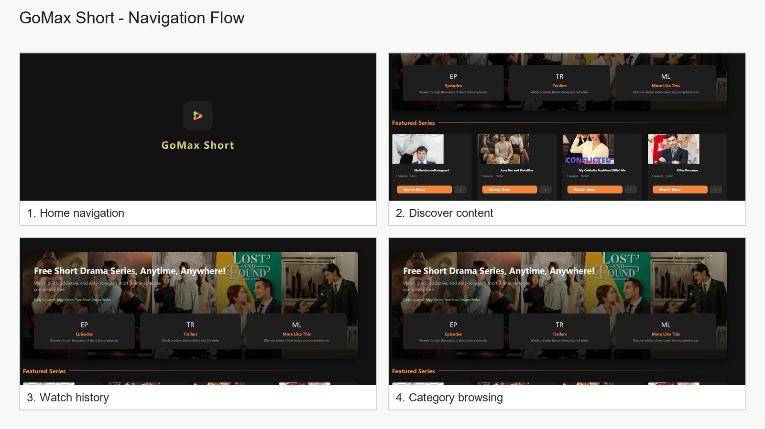

Slide 10
Menu & Function Description
Screen descriptions in the current release:
Home: features hero banner, featured dramas, and quick access cards.
Discover: displays category browsing, trending content, and new releases.
Detail: shows drama poster, synopsis, episode grid, and related content.
Player: full-screen video with episode sidebar and playback controls.
My List: watch history and favorite dramas collection.
Categories: browse dramas by genre and type.
All content is completely free - no subscriptions or payments required!

Slide 11


Slide 12
Key Policy
The current release follows Samsung TV remote control patterns.
Home page: Navigate between main sections and featured content.
Discover / Detail / Player pages: Return navigates to the previous screen.
Player controls: Dedicated media keys control playback functions.
Navigation: Directional keys move focus between interactive elements.
Button | Action | Remarks
ENTER | Select the focused card, button, or episode | Standard selection behavior
UP / DOWN | Move focus vertically | Navigate between sections
LEFT / RIGHT | Move focus horizontally | Navigate within rows
RETURN | Go to the previous screen | Standard back navigation
PLAY / PAUSE | Control video playback | Media control functions
FF / RW | Seek forward/backward 10 seconds | Quick navigation in video
EXIT | Close the application | Platform default behavior
COLOR / CHANNEL / NUMBER KEYS | N/R | No custom mapping in current release
RETURN/EXIT | In case of Game App, if game is terminated, the exit popup should be displayed. | Samsung Mandatory

Slide 13
How to Change Languages
Items | Contents
Language support | This version supports English only. No in-app language change menu is provided.

